Slide 1
Predicting County Health Measures
By: Spencer Duke, Joshua Mayo, Gustavo Bustillos, and David Calero
Notes:
SPENCER PRESENTING

Slide 2


Our Goal
Public and private organizations are constantly concerned with knowing the statistics for various health outcomes in their communities.
Our team wanted to know the feasibility of using a machine learning model to anticipate future statistics for these community health outcomes, aiming to proactively address outcomes that show signs of worsening.
Notes:
SPENCER PRESENTING

Slide 3

Health Measures
After searching through reliable public health data using the County Health Rankings and Roadmaps website, we chose the teen birth rate health measure (number of births per 1,000 female population ages 15-19) as our primary focus.
Secondarily, we wanted to track one other health measure, percent of children living in poverty (percentage of people under age 18 in poverty), to see if a correlation exists between the two measures.
Notes:
SPENCER PRESENTING

Slide 4
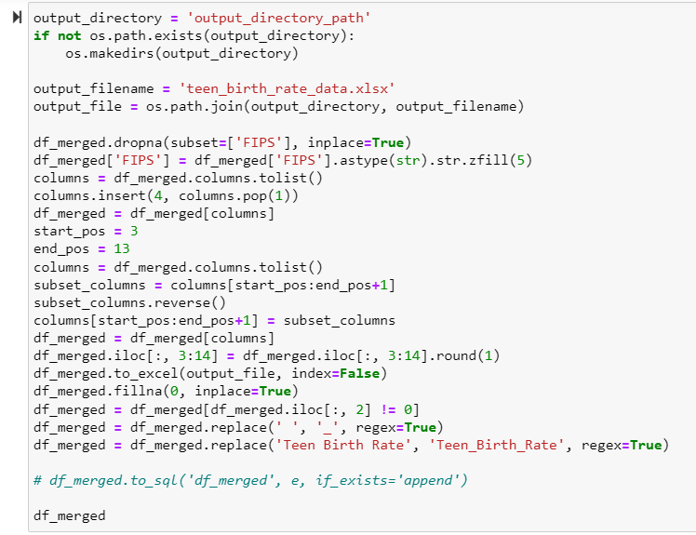
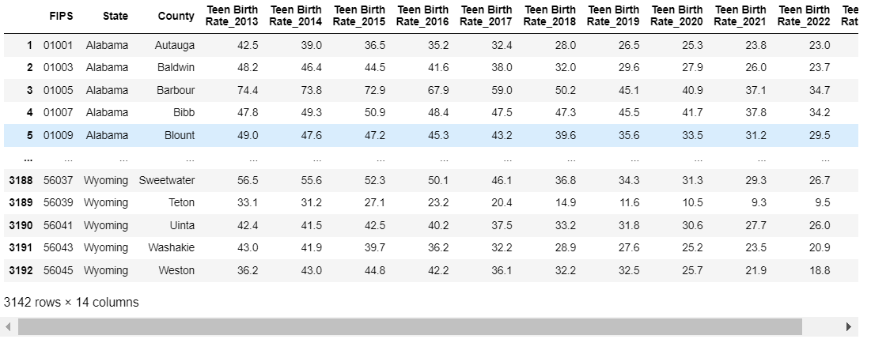
Cleaning The Data
After downloading several tables of public data, we used sqlalchemy to create a database to compile the data.
We then pulled, joined, and cleaned the necessary data from our database, resulting in the table pictured here (we did this for both the teen birth rate and percent of children living in poverty measures).
We later used this as our base table for training our machine learning model.
Notes:
GUSTAVO PRESENTING

Slide 5
Database storage
Each file contained a year of data. After we selected the five relevant columns for out project we cleaned the data with pandas, removed null values, renamed columns and merged the sets to get them ready for the linear regression model.
While working with the files we noticed that reading them took about 100 seconds, not really long, however we saved some time with sqlalchemy, sqlite and pandas, we created a database and saved each document as a table and read them back in this way:
from sqlalchemy import create_engine, text
e = create_engine('sqlite:///teen_birth.db')
df_2023.to_sql('df_2013', e, if_exists='append')
df_2023 = pd.DataFrame(e.connect().execute(text('SELECT * FROM df_2023')))
The raw excel files were 56.3 MB all together and the database containing the same data was 36.5 MB, besides that it saved some space, reading the data was much faster, reading from the database takes only slightly over 2 seconds.

Slide 6

Creating a Machine Learning Model
For the machine learning part of our code, we decided on using a linear regression model. We chose this because of its simplicity, and its ability to act as a reliable baseline to build on and run more complex models in the future.
We used the scikit-learn, commonly referred to as sklearn, open-source machine learning library to build this code.
Notes:
JOSH PRESENTING

Slide 7
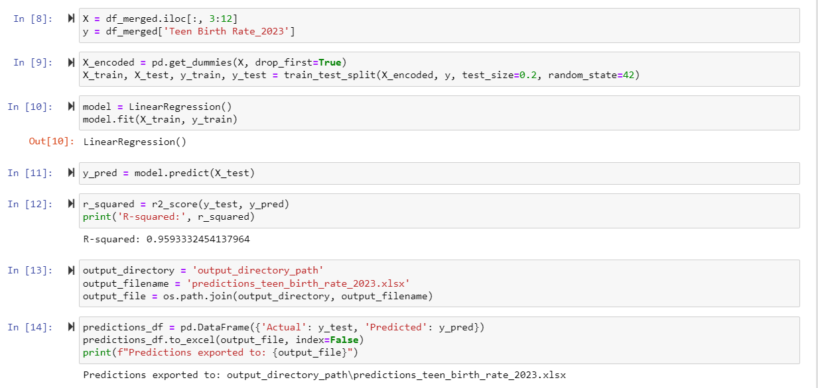
Training the Linear Regression Model
(also done for percent children living in poverty measure)
Notes:
JOSH PRESENTING

Slide 8
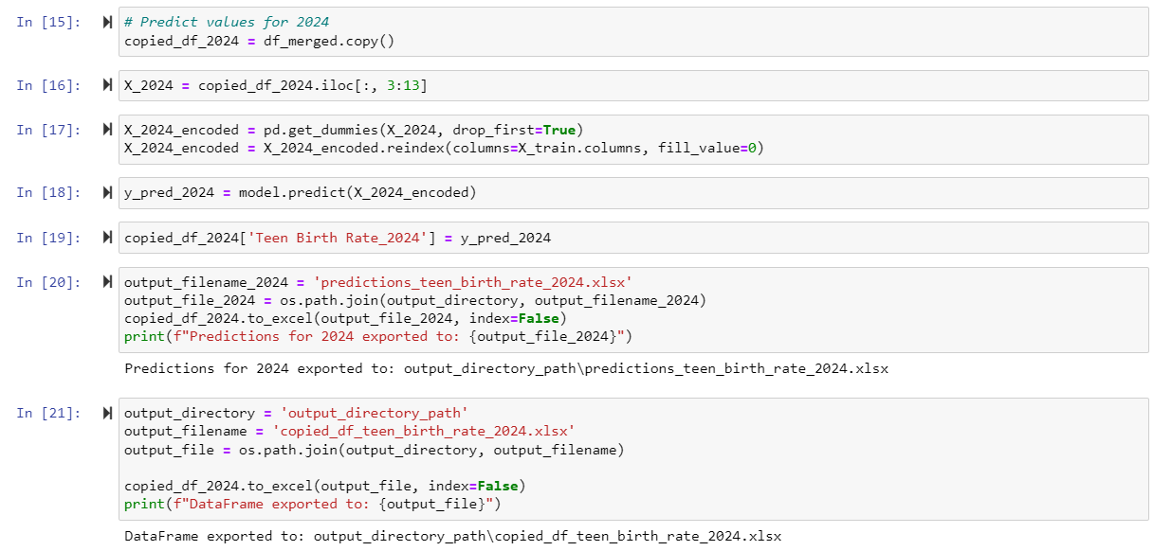
Implementing the Model to Predict 2024 Measure Data (also done for percent children living in poverty measure)
Notes:
JOSH PRESENTING

Slide 9
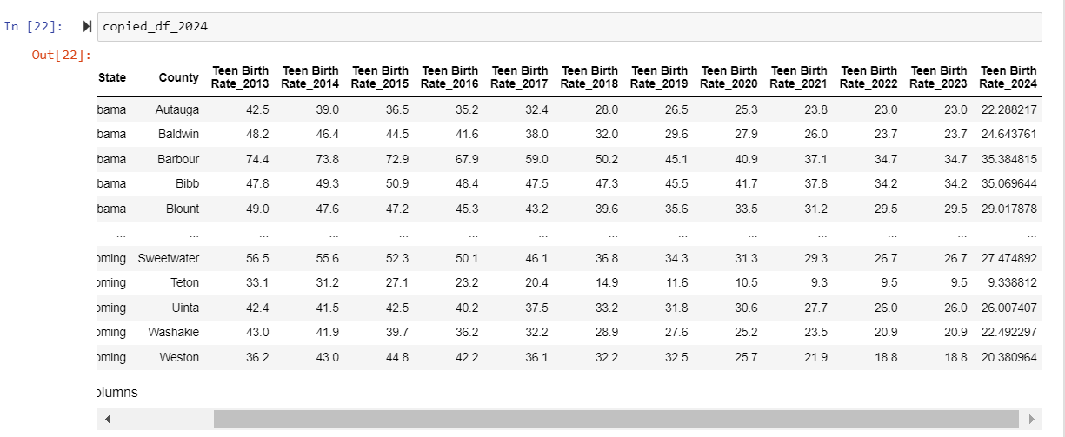
2024 Predictions
(also done for percent children living in poverty measure)
Notes:
JOSH PRESENTING

Slide 10
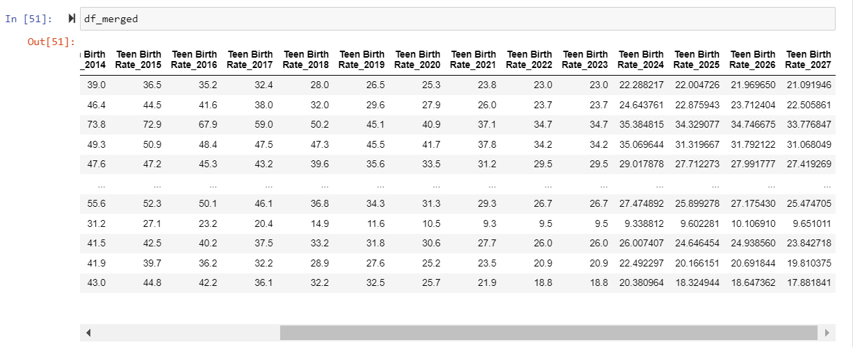
Final Predictions 2024-2027
(also done for percent children living in poverty measure)
Notes:
JOSH PRESENTING

Slide 11
Number of Births per 1,000 Female Population Ages 15-19 Heat Map
Map
By hovering over a state you will see:
  Number of births per 1,000 female population ages 15-19
  Percent of children in poverty
Analysis of Map
  Number of births improves from 2013-2027
  Percent of children in poverty improves
  Massachusetts, New Hampshire, and Connecticut consistently have the lowest number births between 2013-2017
Notes:
SPENCER PRESENTING

Slide 12
Children in Poverty and Teen Birth Rate
2013-2027
https://public.tableau.com/views/Project4_16914646659640/Dashboard1?:language=en-US&:display_count=n&:origin=viz_share_link
Line graphs that show :
  Numbers for Mississippi and New Hampshire (states with highest and lowest poverty rates)
  Highest number of Children in Poverty and Teen Birth Rate.
  Lowest number of Children in Poverty and Teen Birth Rate.
Notes:
DAVID PRESENTING

Slide 13
Findings/Conclusion
Both the teen birth rate and percent of children living in poverty health measures have been consistently decreasing, and our machine learning model predicts that this trend will continue.
However, there are moments where slight upticks in these measures can be observed, before ticking back down.
Overall, there is a noticeable correlation between the two measures that can be observed; however, it is important to avoid concluding causation between these measures (correlation does not equal causation). More data would be needed from other health measures to better understand the full picture of each geographic area’s population health.
However, this data could be presented to public or private health organizations to help them know where to focus resources, and brainstorm actions that can be taken to further address these measures or other, more pressing, measures.
It may also be used to help spur further, more detailed, investigations by public or private organizations to determine the extent of how poverty relates to teen births.
Notes:
JOSH PRESENTING

Slide 14


